Slide 1
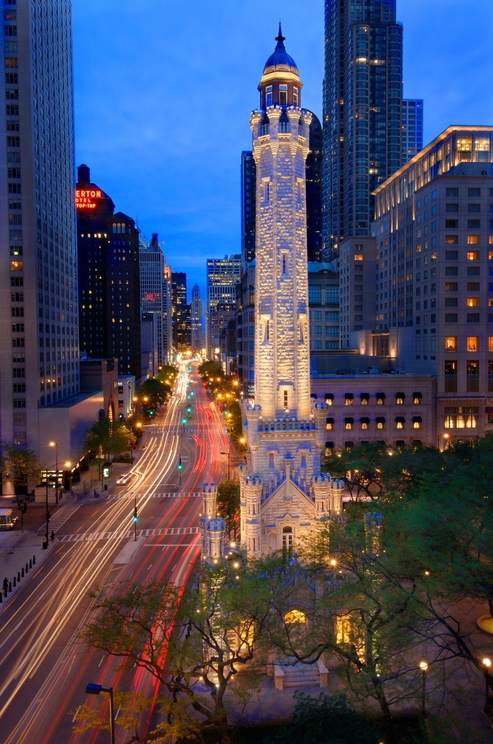

Chicago Department of Water Management
Hacia
April 9, 2014
Thomas H. Powers, P.E.
Commissioner

Slide 2
Water System Overview
Background
Drinking water treatment
  Water Quality (Microbiology, Chemistry, & Microscopy), Water Treatment
Water distribution system maintenance
  Water Pumping, Operations & Distribution, Engineering
Combined sewer system maintenance
  Operations & Distribution, Engineering
Metropolitan Water Reclamation District of Greater Chicago treats wastewater
2
Notes:
First, let me provide you with a little background about our department. After merging the water department and sewer department in 2003, we became not only responsible for the treatment and distribution of the drinking water, but also the transmission of waste water to the Metropolitan Water Reclamation District.

Slide 3
Chicago Water System Overview
Protecting public health & safety
2 Lake Intake Structures
2 Water Purification Plants
  Jardine: 1.4 BGD rated capacity
  South: 720 MGD rated capacity
12 Water Pumping Stations
  8 Electric, 4 Steam
  No elevated storage
4,349 Miles of Dist. Mains
  48,243 Fire Hydrants
  > 600 miles of transmission mains
    Ranging in size from 16-inch to 78-inch diameter

Slide 4
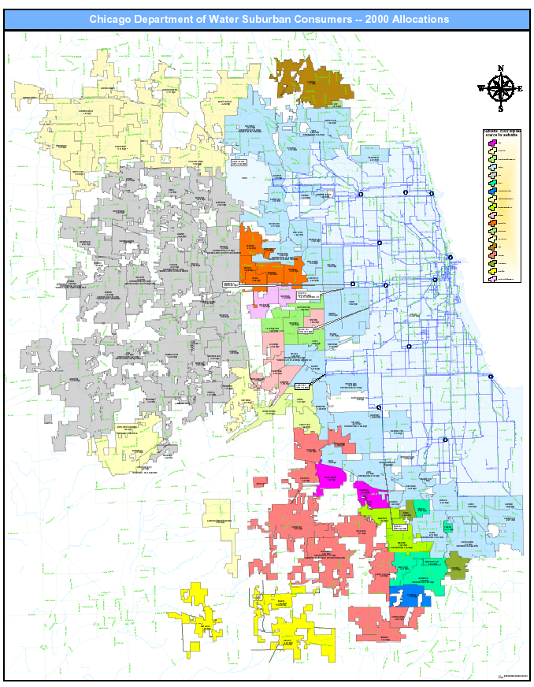
Water Supply Area
Suburban Consumers
City & Suburban 2010 Population Served by DWM
Total Population of IL 12.83M
City (Water & Sewer) | 2.70M | 21% of IL
Suburban (Water) | 2.67M | 21% of IL
Total (Water) | 5.37M | 42% of IL
42.5%
42% of Ill.

Slide 5
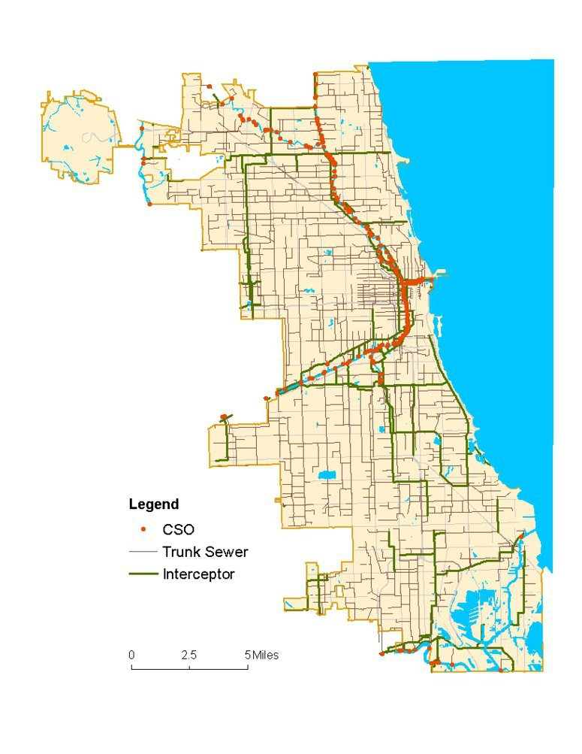
Sewer System Overview
North Side WRP
Combined Sewer System
188 square miles of drainage area
4,600 miles of sewer
250,000 catch basins
125,000 manholes
200 Combined Sewer Overflows (CSOs)
Sewer diameters 8-inches to 21.5-feet
Stickney WRP
Calumet WRP

Slide 6

2012-2015 Rate Increase
January 1 | Water Rate Increase | Sewer Rate (as a % of water) | Avg. Total Annual Bill | Annual Increase | Daily Increase | Cost Per 1,000 Gallons | Cost Per Shower
2012 | 25% | 89% | $431.30 | $91.70 | $0.30 | $2.51 | $0.13
2013 | 15% | 92% | $503.80 | $72.60 | $0.20 | $2.88 | $0.14
2014 | 15% | 96% | $591.40 | $87.90 | $0.20 | $3.31 | $0.17
2015 | 15% | 100% | $694.10 | $102.60 | $0.30 | $3.81 | $0.19
Cost per shower = $0.13 in 2012
$0.19 in 2015

Slide 7
Projected Water CIP Spending
Bond Proceeds
Pay-go Funds
IEPA Funds
Projected Bond
Proceeds
Projected Pay-go Funds
Projected IEPA Funds
7

Slide 8
Projected Sewer CIP Spending
Bond Proceeds
Pay-go Funds
IEPA Funds
Projected Bond
Proceeds
Projected Pay-go Funds
Projected IEPA Funds
8

Slide 9
2013 & 2014 DWM CIP Distribution System
 | 2011 Completed | 2012 Completed | 2013 Completed | 2014 Targets
Water Mains Replacement | 30 Miles | 70 Miles | 75 Miles | 85 Miles
In-House Crews | 18 (60%) | 30 (42%) | 30 (40%) | 35 (41%)
Contractor * | 12 (40%) | 40 (58%) | 45 (60%) | 50 (59%)
Sewer Mains Replacement | 9 Miles | 17 Miles | 17 Miles | 21 Miles
In-House Crews | 7 (75%) | 10 (60%) | 10 (60%) | 12 (57%)
Contractor | 2 (25%) | 7 (40%) | 7 (40%) | 9 (43%)
Sewer Lining (Contractor)* | 40 miles | 47 Miles | 49 Miles | 55
Structure Lining (Contractor) | 14,000 | 14,000 | 14,000 | 14,000
Install Meters* | 8,000 | 12,000 | 12,000 | 15,000
* Funded in part by IEPA SRF

Slide 10
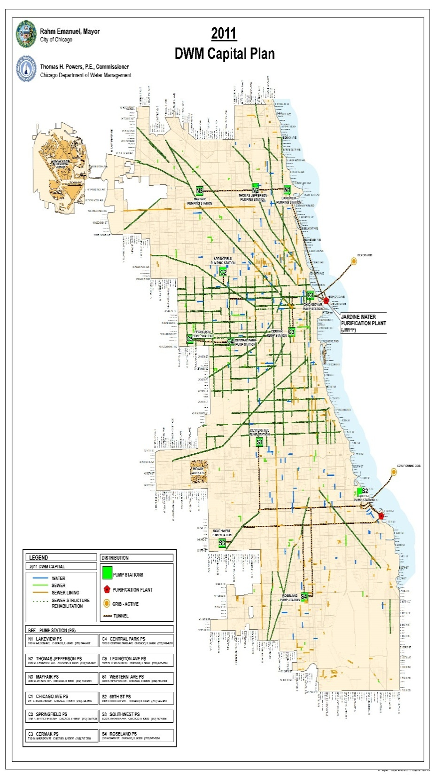
2011 Water
& Sewer Capital Program
2011 CIP Program
Water Main Replacement = 30 Miles
Sewer Main Replacement = 9 Miles
Sewer Lining = 40 Miles
Sewer Structure Rehabilitation = 8,000
Water Meter Installations = 8,078
2011 Capital Expenditures*: $225.5M
2011 Operating Expenditures: 702.4M
10
*Expenditures include Facility Capital Improvements
Notes:
Budget less paygo

Slide 11
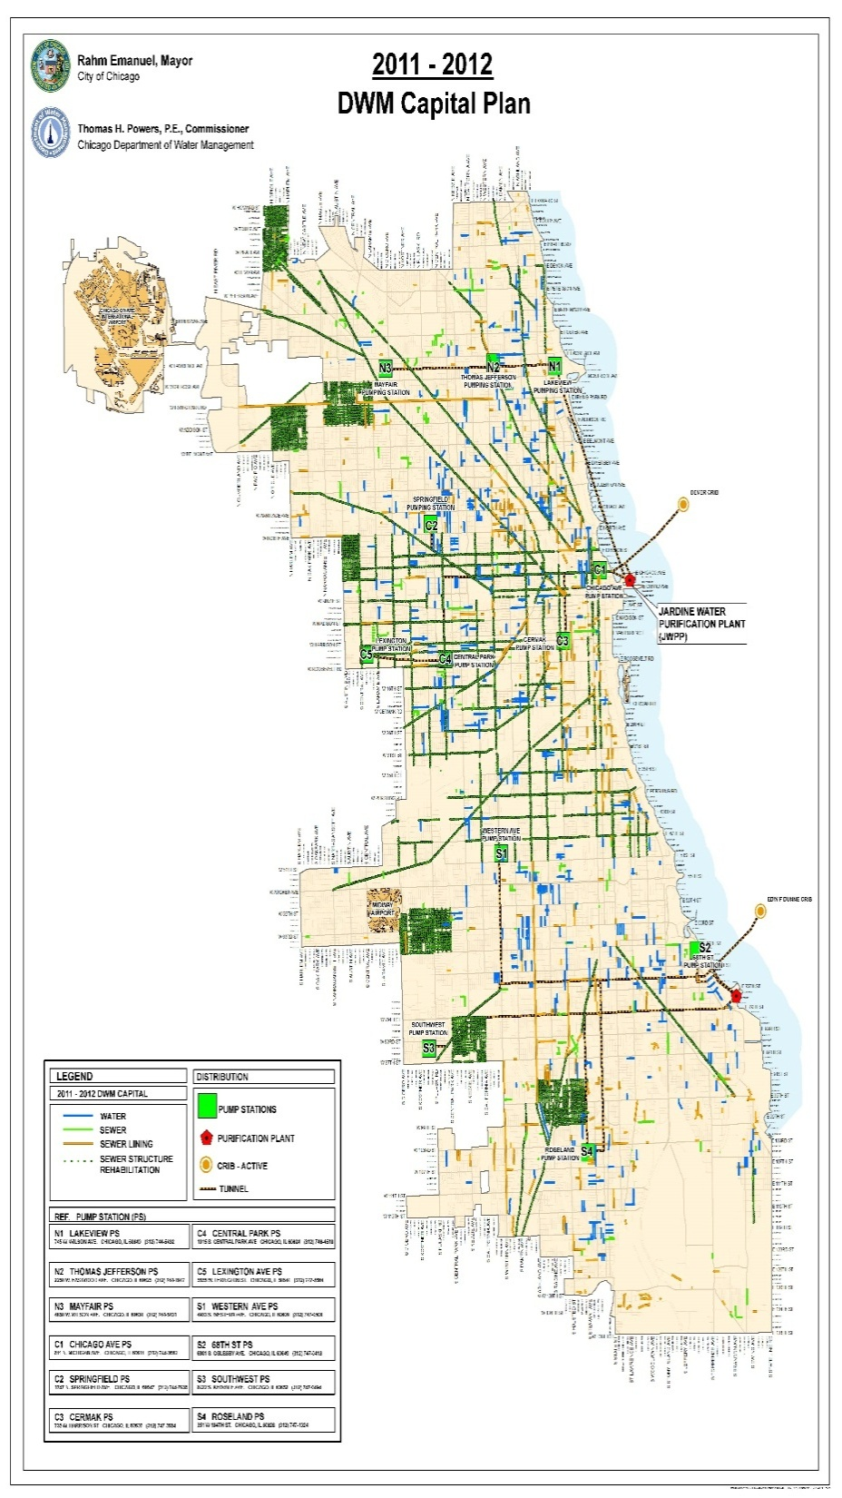
2011-12 Water
& Sewer Capital Program
2012 Program
Water Main Replacement = 70 Miles
Sewer Main Replacement = 17 Miles
Sewer Lining = 47 Miles
Sewer Structure Rehabilitation = 14,000
Water Meter Installations = 12,160
2012 Capital Expenditures*: $422.1M
2012 Operating Expenditures: 748.4M
11
*Expenditures include Facility Capital Improvements

Slide 12
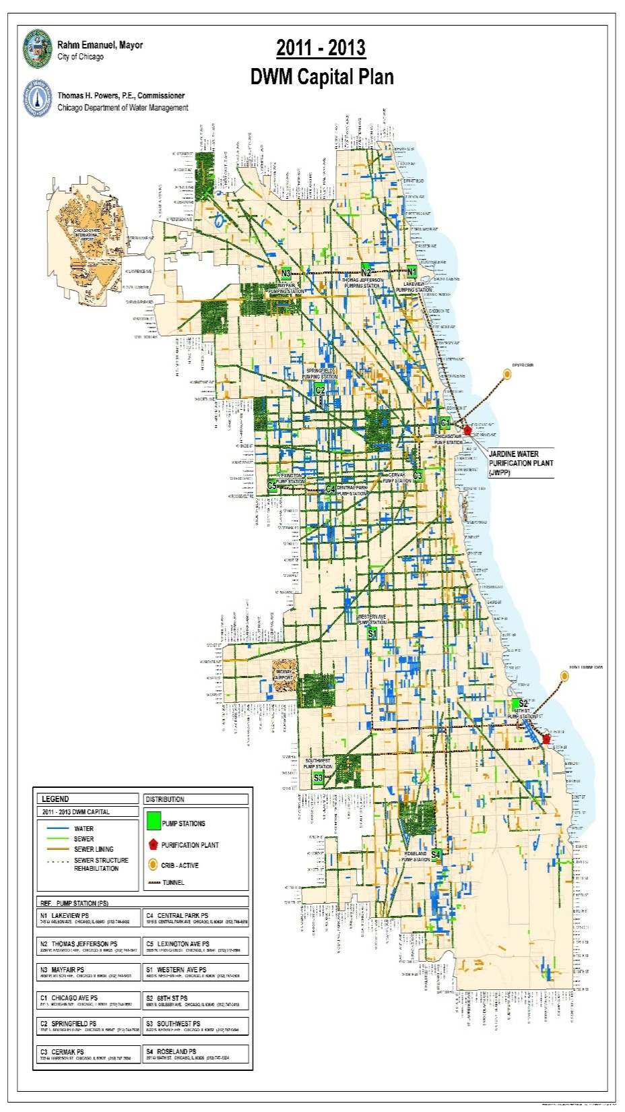
2011-13 Water
& Sewer Capital Program
2013 Program
Water Main Replacement = 75 Miles
Sewer Main Replacement = 17 Miles
Sewer Lining = 49 Miles
Sewer Structure Rehabilitation = 14,000
Water Meter Installations =16,393
2013 Capital Expenditures*: $542M
2013 Operating Expenditures: 784M
12
*Expenditures include Facility Capital Improvements

Slide 13
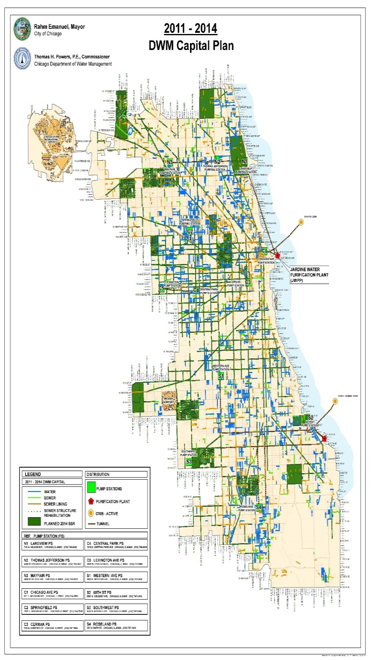
2011-14 Water
& Sewer Capital Program
2014 Program - GOALS
Water Main Replacement = 85 Miles
Sewer Main Replacement = 21 Miles
Sewer Lining = 55 Miles
Sewer Structure Rehabilitation = 15,000
Water Meter Installations = 15,000
2014 Capital Expenditures*: $671M
2014 Operating Expenditures: 817M
2011–14 Capital Expenditures
$1.86B
2011–14 Operating Expenditures
$3.1B
13
*Expenditures include Facility Capital Improvements

Slide 14
DWM CIP -Distribution System Contracts in Place
7 water main installation
  3-year term contracts w/2 optional extensions
  Smaller contracts to increase participation
3 city-wide sewer main installation contracts
7 location-specific sewer main installation contracts
5 city-wide lining contracts
3 structure lining contracts
14

Slide 15
DWM CIP – Water Engineering Contracts
New T.A.s will be Solicited in early 2015. Current include:
    17 T.A. with consulting engineering/architectural firms for design engineering services
    11 T.A. with consulting engineering/architectural firms for C.M. services
Existing Contracts Include:
    11 T.A. for topographic survey & base map production
    1 T.A. consulting engineering for specialized structural engineering services
    1 program management contract
    1 hydraulic engineering contract
15

Slide 16
DWM CIP – Sewer Engineering Contracts
New T.A.s will be Solicited in early-2015. Current include:
    12 T.A. with consulting engineering/architectural firms for design engineering services
    10 T.A. with consulting engineering/architectural firms for C.M. services
Existing Contracts Include:
    2 sewer hydraulic modeling contract
16

Slide 17
DWM CIP – Facility Projects
17

Slide 18
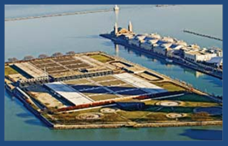
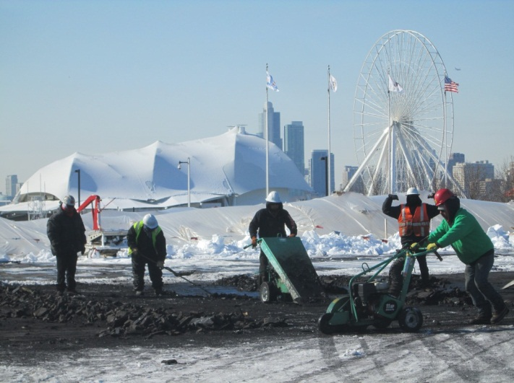
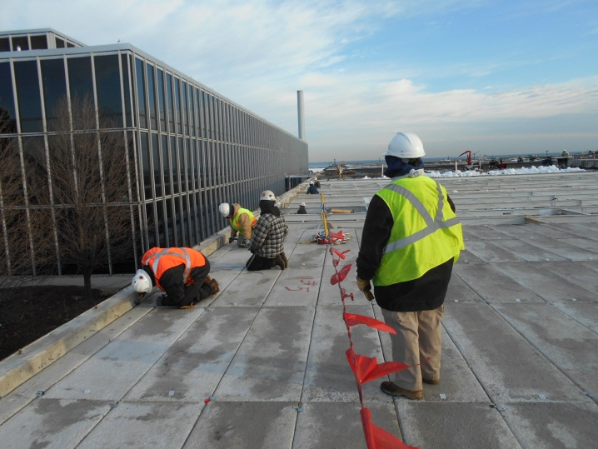
Facility Improvements
Jardine Water Purification Plant
10-acre E. Filter Building Roof Replacement
6 of 8-Phase Project completed
Construct temporary scaffolding – to maintain uninterrupted water treatment
Remove & install new concrete panels & roof membrane
Lead abatement
Remove & replace select damaged steel beams & columns
Paint steel
Cost for design & construction $37.5M
Est. complete July 2014
18

Slide 19
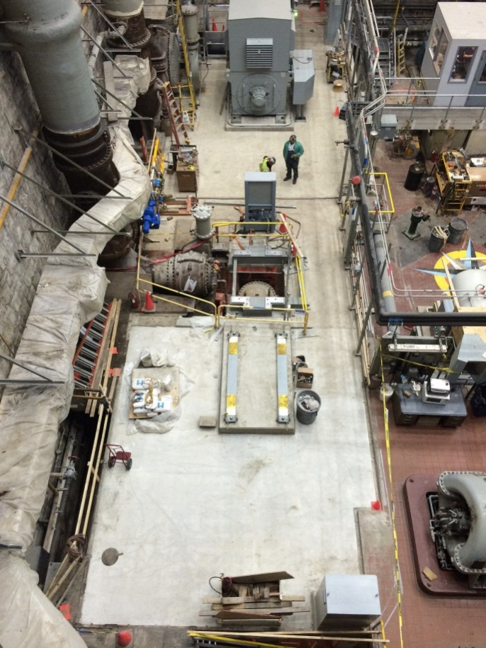
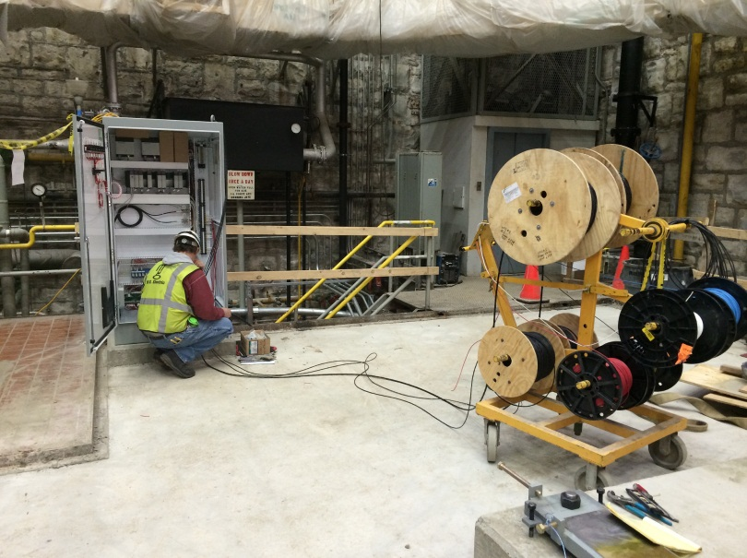
Facility Improvements
Springfield Pumping Station Conversion
Replace existing steam turbines on 5 pumps with electric motors
Construct LEED certified building & ComEd Vault to house new electrical equipment & control room
Construct green roof
Install solar panels
2of 5 pumps has been converted
3rd pump has been refurbished & installed on a new base
19

Slide 20
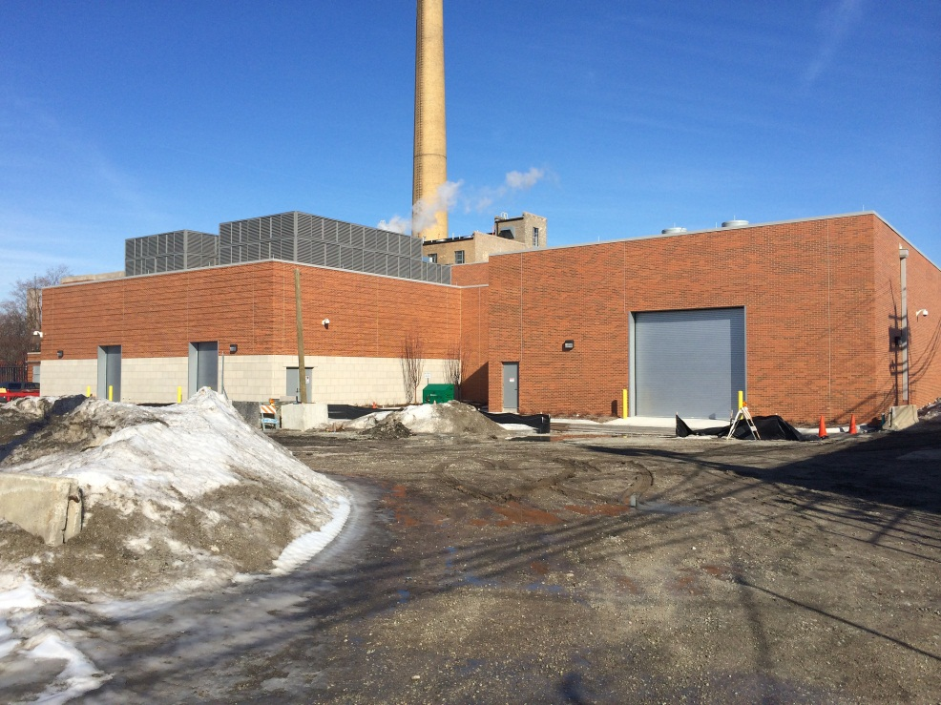
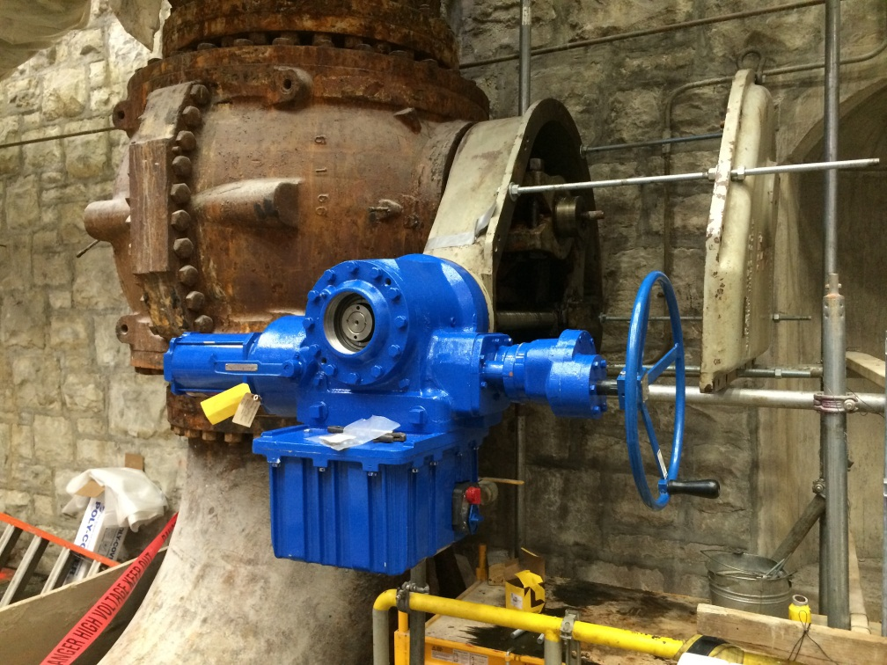
Facility Improvements
Springfield Pumping Station Conversion, Con’t
Cost for design and construction is $73M
Estimated energy, maintenance & personnel savings $4.5M annually
Estimated complete July 2015
New Discharge Valve Operator for Pump 3
New LEED certified building & ComEd Vault housing new electrical equipment & control room
20

Slide 21
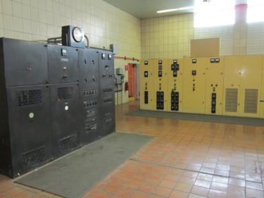
Facility Improvements
SWPP Switchgear & Generator Replacement
Replace of existing 1940’s era Medium Voltage Switchgear throughout the South Water Purification Plant
Replace temporary standby generators & install permanent generators
$44.7 Bid Construction Bid (in award process)
Construction Start: 2014
3+ year Project
21

Slide 22
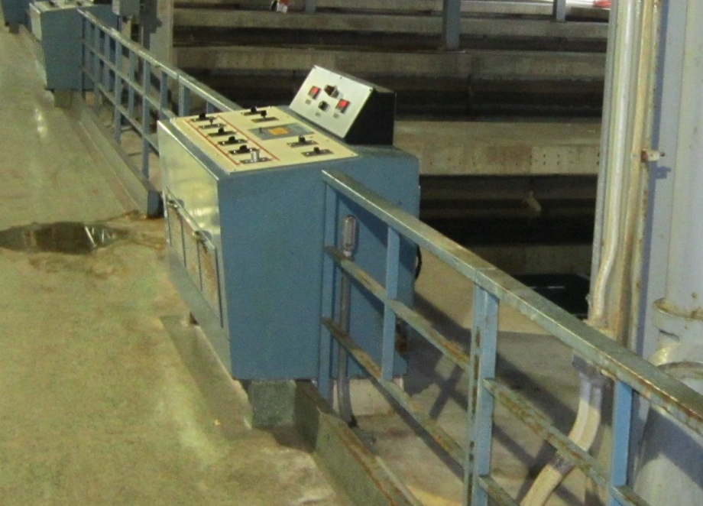
Facility Improvements
SWPP Filter Control System Replacement
(120 filters)
Design started in 2013 – 60% submitted & reviewed in March 2014
Replace 1980’s-era Filter Backwash Control System with a new PLC Digital Filter Backwash Control System.
Plan to advertise for bid in 4th Quarter 2014
$20M Est. Cost
22

Slide 23
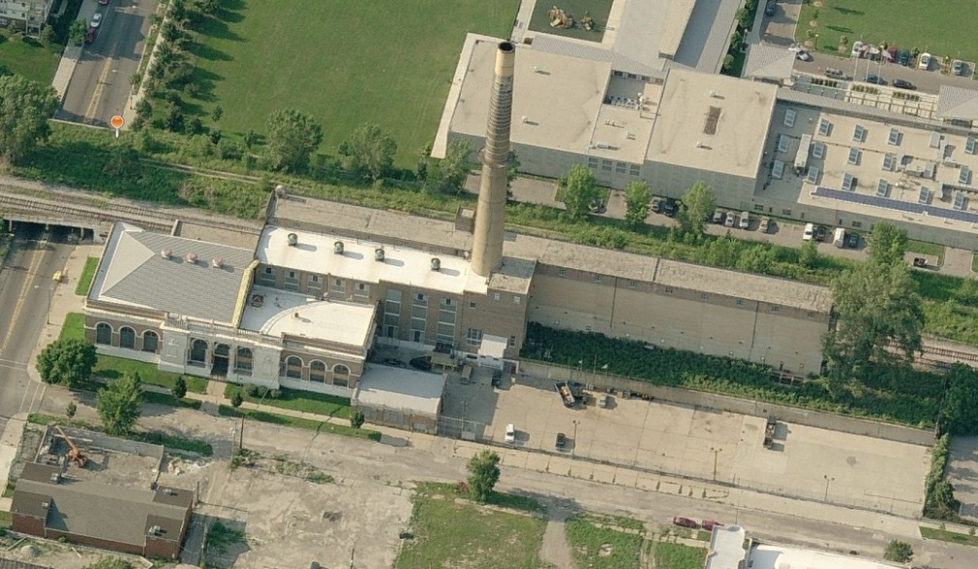
Facility Improvements
Central Park Pumping Station Electrification (Upgrade electrical motors & variable frequency drives)
Design Project recently awarded
  Scope & Fee for 1st phase includes:
    Evaluation of alternatives for electrical & variable frequency drive improvements
    Establishment of design requirements including geotechnical, architectural, structural requirements, hazardous material removal, and others
  $80M Construction Estimate
  Construction Start 2015 or 2016
23

Slide 24
Summary
10 Year Goal: Back on Original Installation Pace
Water 2012-2021
880 miles - water mains
4 designs - pump stations
3 conversions – pump stations
> 200,000 install meters
Sewer 2012-2021
244 miles - sewer mains
455 miles – sewer lining
140,000 structure lining
24

Slide 25
Questions

